Slide 1
A Strategic Analysis for Microsoft's New Movie Studio

Slide 2
TABLE OF CONTENTS
01
PROJECT OVERVIEW
02
DATA SOURCES
03
KEY FINDINGS
04
VISUAL INSIGHTS
RECCOMENDATIONS
05

Slide 3
01
PROJECT OVERVIEW

Slide 4
Microsoft's New Studio
Microsoft is starting a new movie studio and needs to make smart decisions on film production.
Objectives of Analysis
We aim to find out:
Which movie genres are most popular.
How production budgets affect box office earnings.
The best movie runtime for high ratings.
Purpose
Use data to guide decisions and help the studio produce successful films.

Slide 5
DATA SOURCES
02

Slide 6

IMDB Data
Includes movie genres, ratings, and runtimes.
Box Office Mojo Data
Provides details on domestic and international box office grosses.
Combined Data
Merging these datasets gives a complete view of movie performance and financial success.

Slide 7
03
KEY FINDINGS

Slide 8
Popular Genres: Identified genres with the highest average ratings and best box office results.
Budget Impact: Showed how different production budgets affect financial success.
Optimal Runtime: Found the ideal movie length for achieving high ratings.

Slide 9
Visual Insights
04

Slide 10
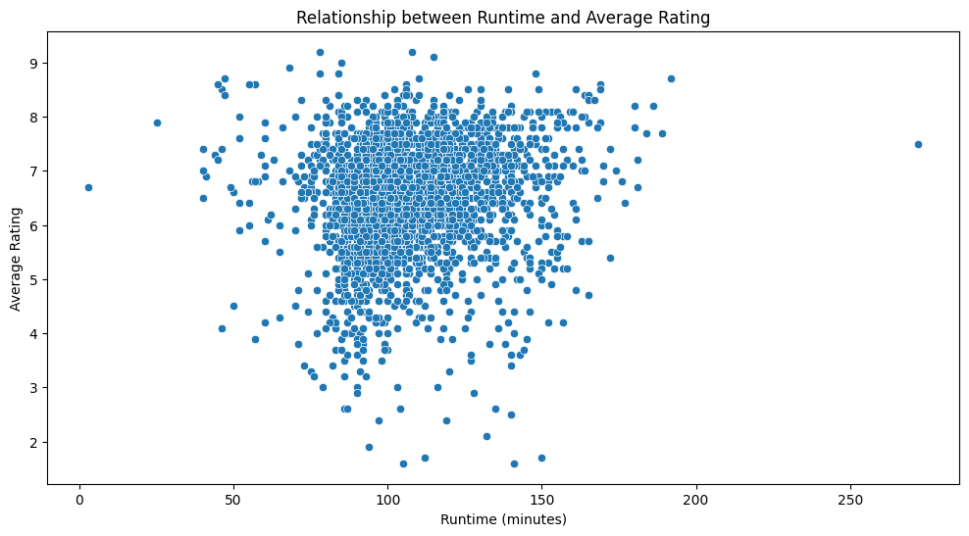
Exploring the Relationship Between Runtime and Average Rating
Graph of how the runtime of a movie correlates with its average rating.

Slide 11
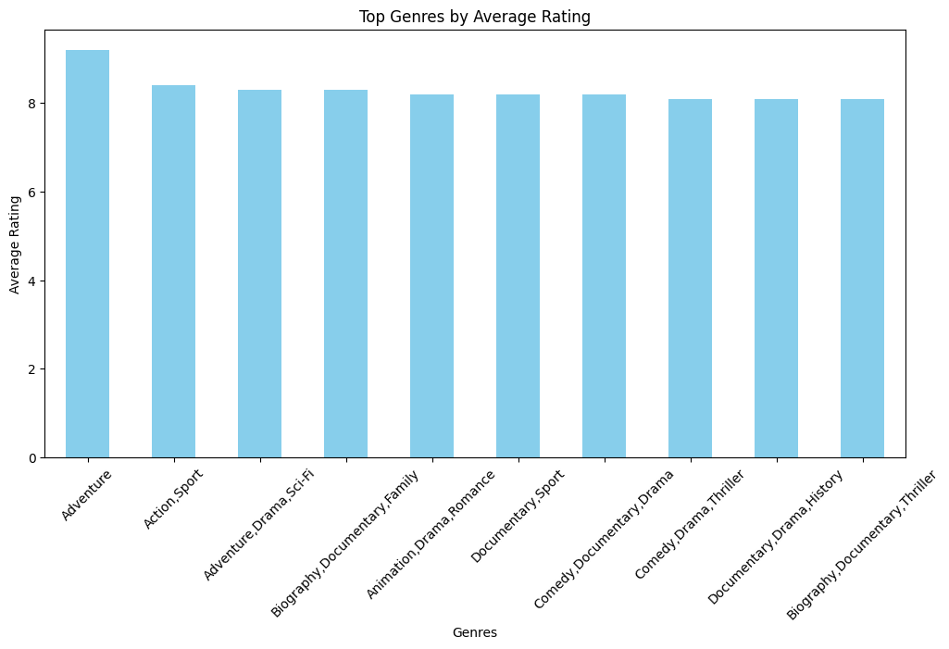
Analysis of Movie Genres by Average Rating
Analysis of the performance of different movie genres based on their average

Slide 12
CONCLUSION
The study shows that Microsoft's new studio should focus on genres with higher average ratings for increased film success. Optimizing investment in high-performing genres and generations is essential, thus strategic budget allocation to each genre demands careful consideration that can drive the maximum leverage for box office returns. Moreover, the IPs are also on board to target runtimes that cater audience experience even better with critical acclaim. In proceeding with these elements of VPF— genre preferences, budget investment; run-time —the studio can undergo a better-utilized approach to the film industry and have data-driven results as their voice.

Slide 13
RECCOMENDATIONS
Focus on Top Genres: Produce more movies in genres with high ratings and strong box office performance.
Smart Budgeting: Allocate production budgets to maximize returns based on genre success.
Ideal Runtime: Target runtimes that align with successful movies to improve ratings.
Strategic Planning: Use these insights to make informed decisions and enhance film production success.

Slide 14


